Slide 1


Slide 2
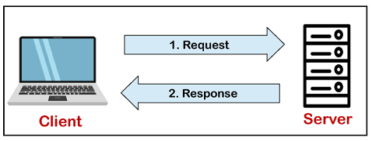
What is MYSQL?
MySQL is currently the most popular database management system software used for managing the relational database.
It is open-source database software, which is supported by Oracle Company. It is fast, scalable, and easy to use database management system in comparison with Microsoft SQL Server and Oracle Database.
MySQL is the relational database management system.
MySQL used for developing web based software development.
Developed by Company MySQL AB a Swedish company.

Slide 3
Database Structure:
SERVER (Transfer HTTP Request ) DATABASE
(User Data’s are stored )
CLIENT ( We will access the software's in Mobile or computers/laptops).
MySQL
ORACLE
SQL SERVER

Slide 4
WHAT IS DATABASE?
A database is an application that stores the organized collection of records.
It can be accessed and manage by the user very easily.
It allows us to organize data into tables, rows, columns, and indexes to find the relevant information very quickly.
Each database contains distinct API for performing database operations such as creating, managing, accessing, and searching the data it stores.

Slide 5
What is RDBMS?
RDBMS stands for Relational Database Management Systems..
All modern database management systems like SQL, MS SQL Server, IBM DB2, ORACLE, My-SQL and Microsoft Access are based on RDBMS.
It is called Relational Data Base Management System (RDBMS) because it is based on relational model introduced by E.F. Codd.
Data is represented in terms of tuples (rows) in RDBMS. Relational database is most commonly used database.
It contains number of tables and each table has its own primary key. Due to a collection of organized set of tables, data can be accessed easily in RDBMS.

Slide 6
What is SQL?
SQL stands for Structured Query Language
SQL lets you access and manipulate databases
SQL became a standard of the American National Standards Institute (ANSI) in 1986, and of the International Organization for Standardization (ISO) in 1987
What Can SQL do?
SQL can execute queries against a database
SQL can retrieve data from a database
SQL can insert records in a database
SQL can update records in a database
SQL can delete records from a database
SQL can create new databases
SQL can create new tables in a database
SQL can create stored procedures in a database
SQL can create views in a database
SQL can set permissions on tables, procedures, and views

Slide 7
NOSQL DATABASE:
MongoDB, CouchDB, CouchBase , Amazon SimpleDB, Riak, Lotus Notes are document-oriented NoSQL databases,.
Neo4J, InfoGrid, Infinite Graph, OrientDB, FlockDB are graph databases.

Slide 8
What is Database & Tables MySQL? BACKEND RDBMS
COLLEGE DATABASE
PRIMARY KEY
COURSE
CID
COURSENAME
COURSE_TYPE
SUBJECTS
SUID
DUB_NAME
CID
COURSE_YEAR
SEM
APPLICATION
ID
NAME
FATHER
CID
ROLLNO
UNIQUE CID
ATTENDANCE
AID
ATT_DATE
ID
RELIGION
ROLLNO
FOREIGN KEY
Tables

Slide 9
Features of MySQL
Relational Database Management System (RDBMS)
Easy to use
Storing data is secure.
Open Source & Free to download.
Compatible on many operating systems.

Slide 10
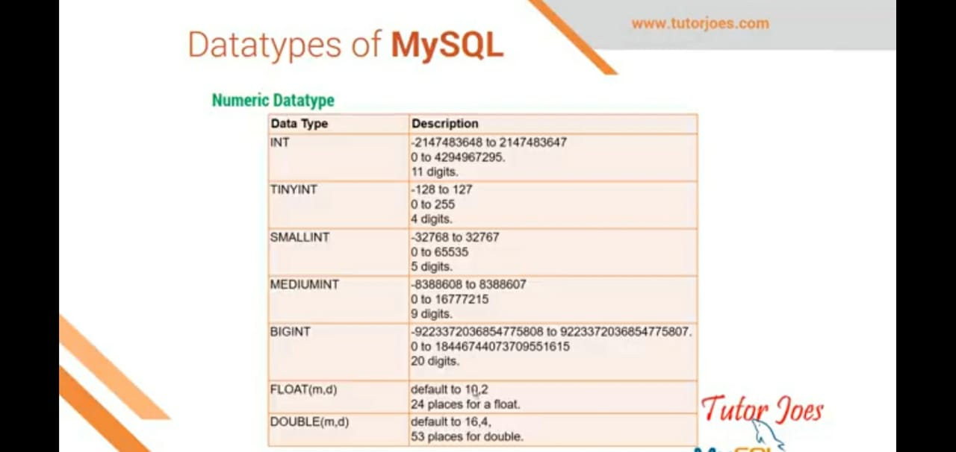
Datatypes of MySQL

Slide 11
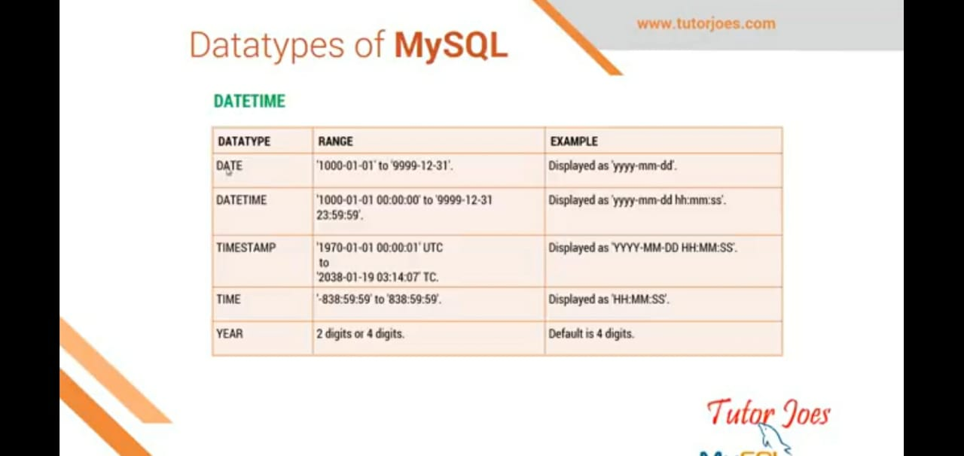

Slide 12
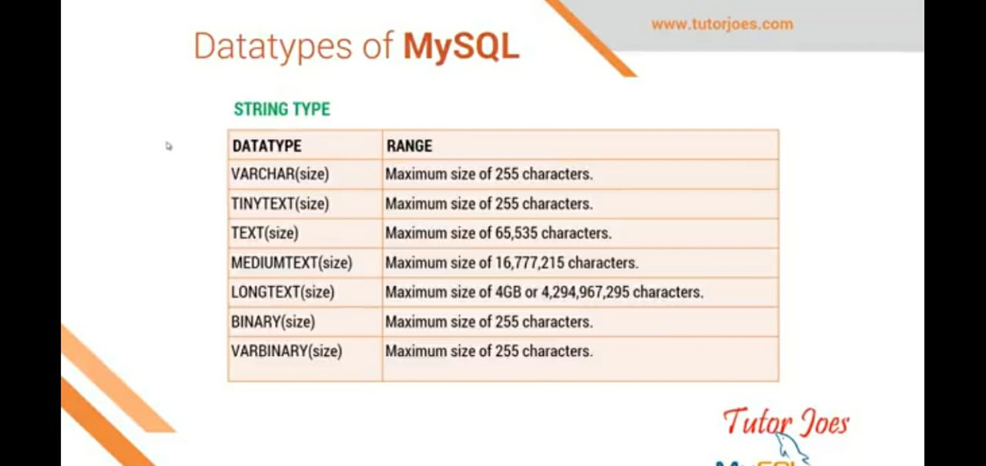

Slide 13
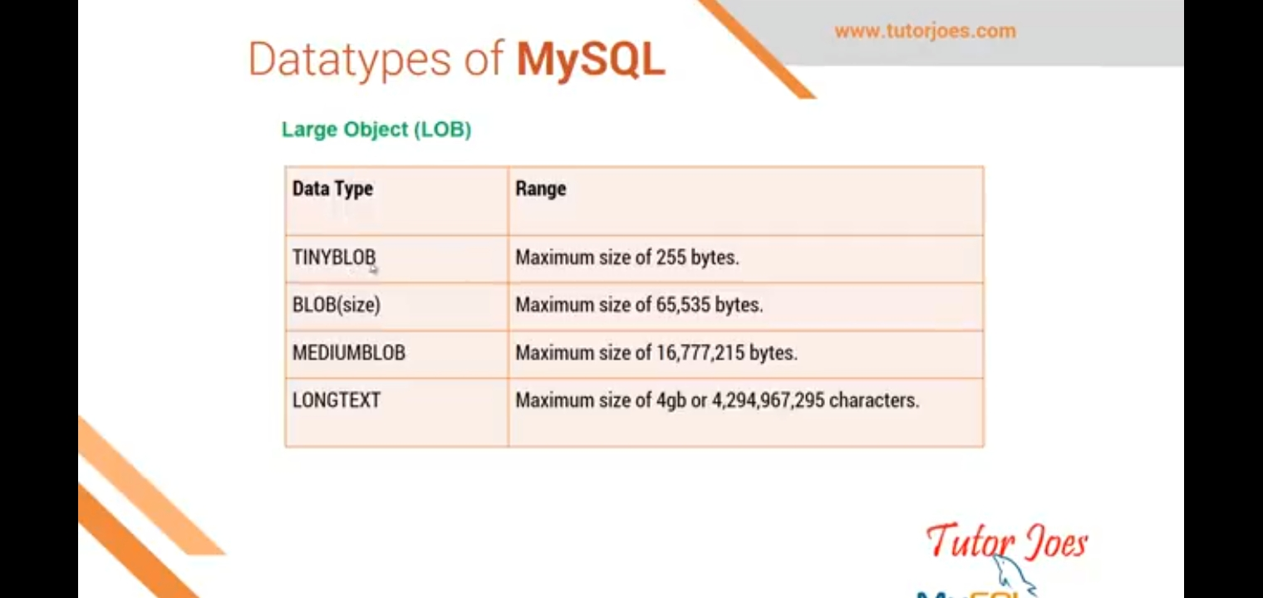

Slide 14
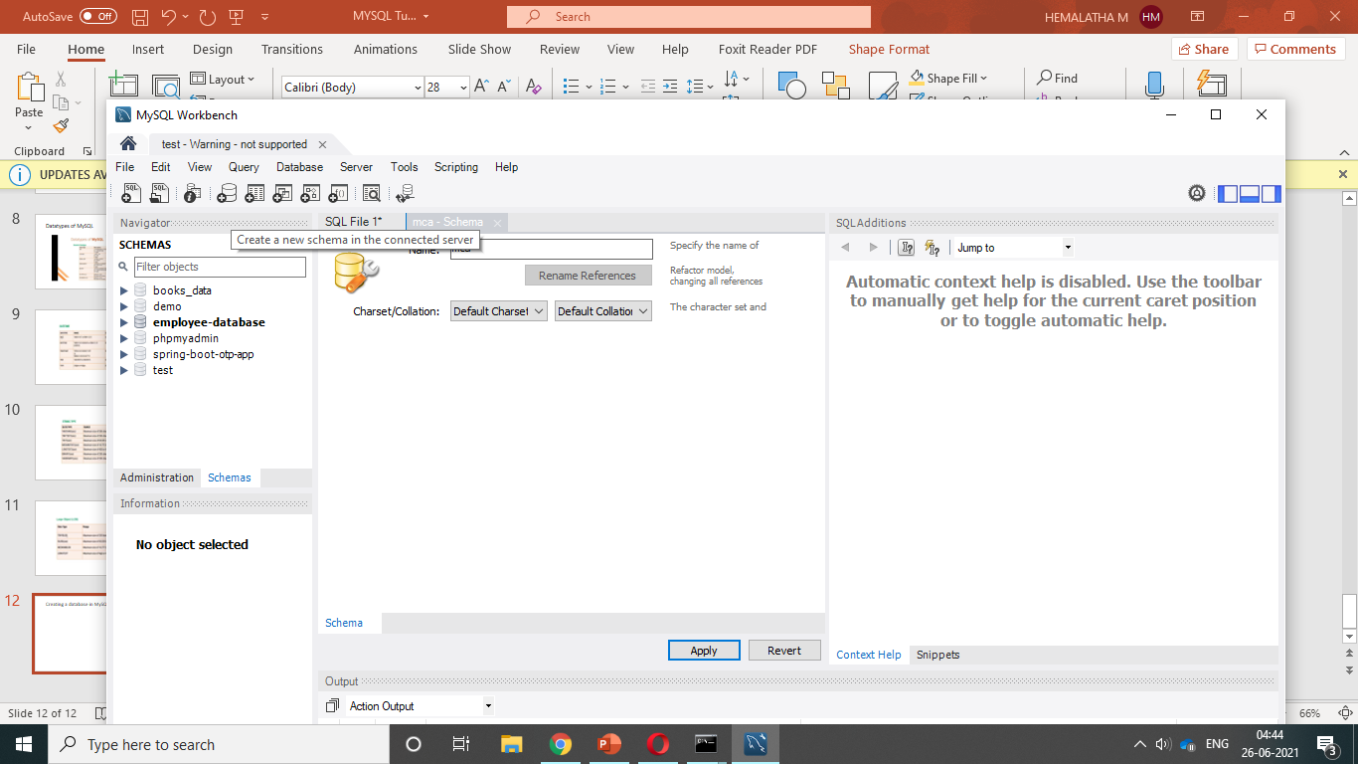
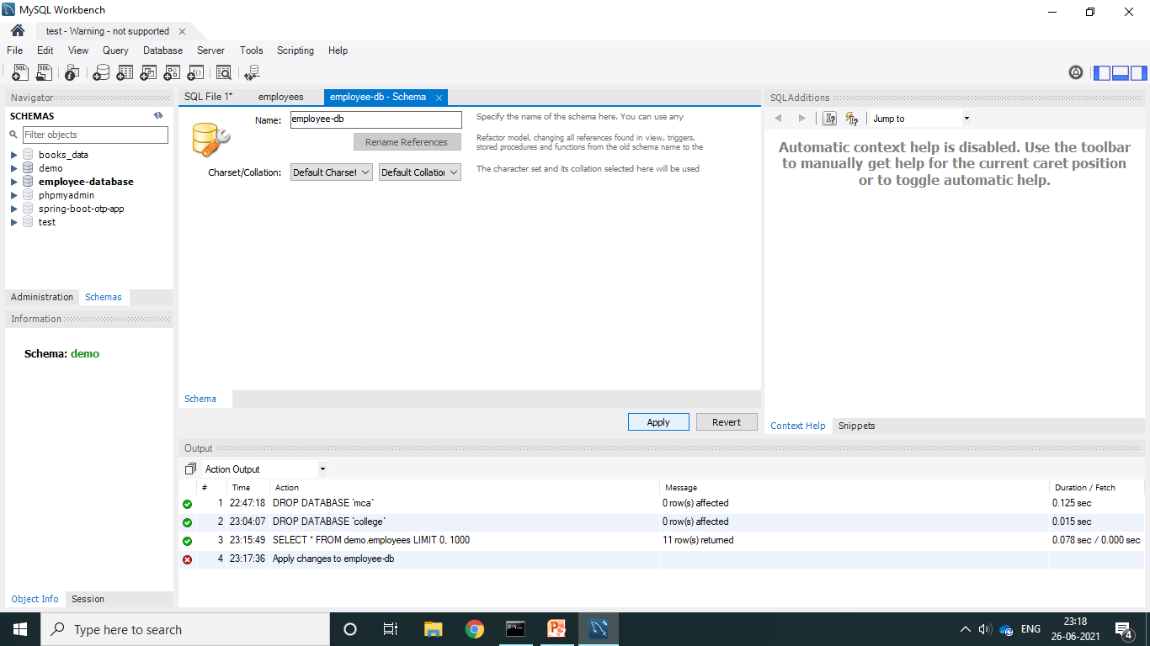
Creating a database in MySQL workbench

Slide 15
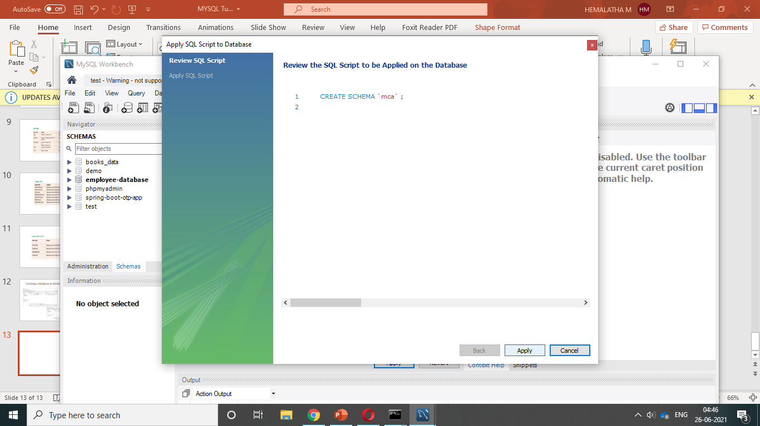
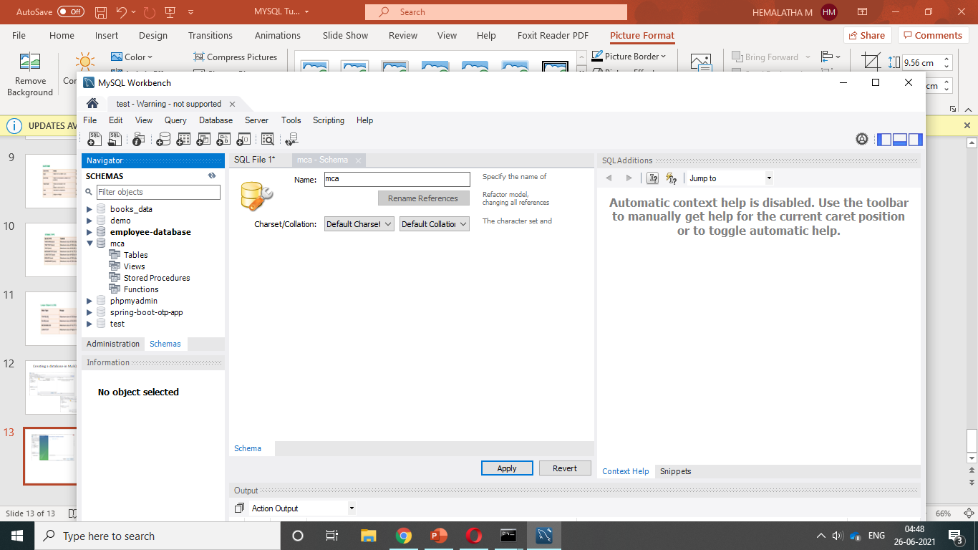

Slide 16
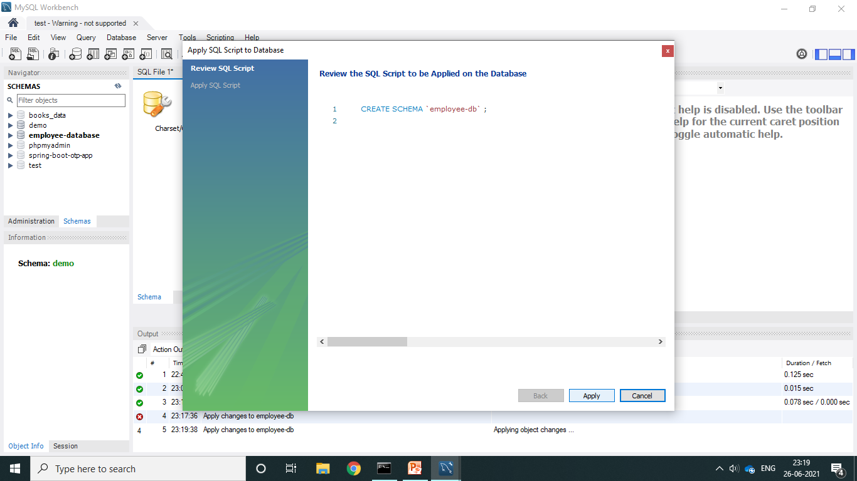
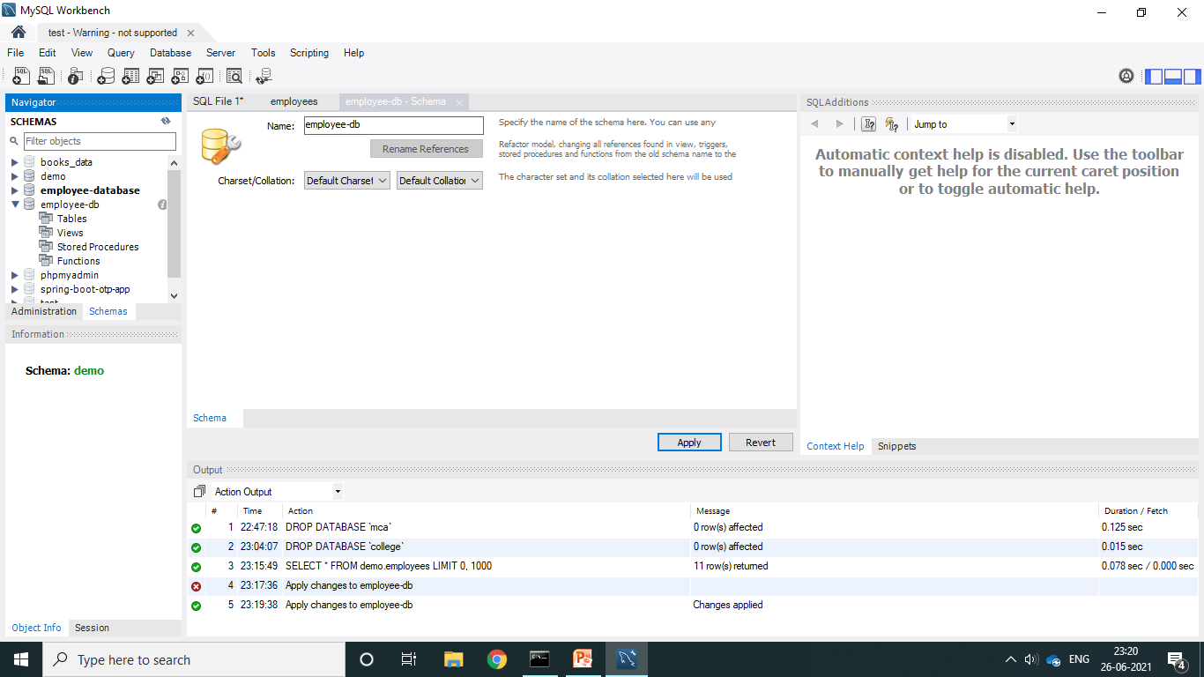

Slide 17
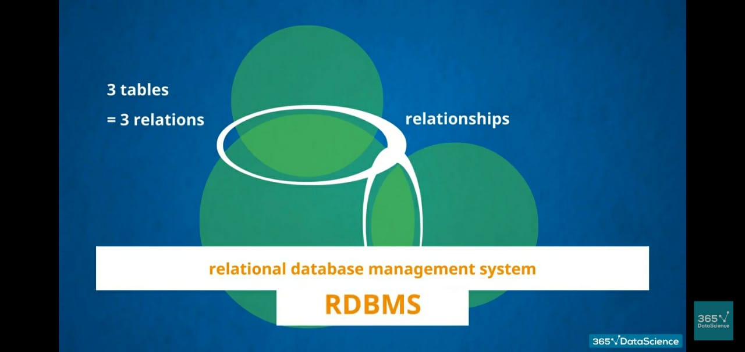
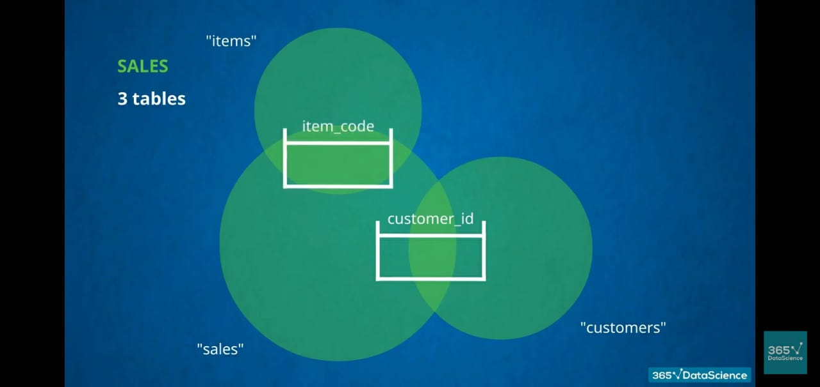
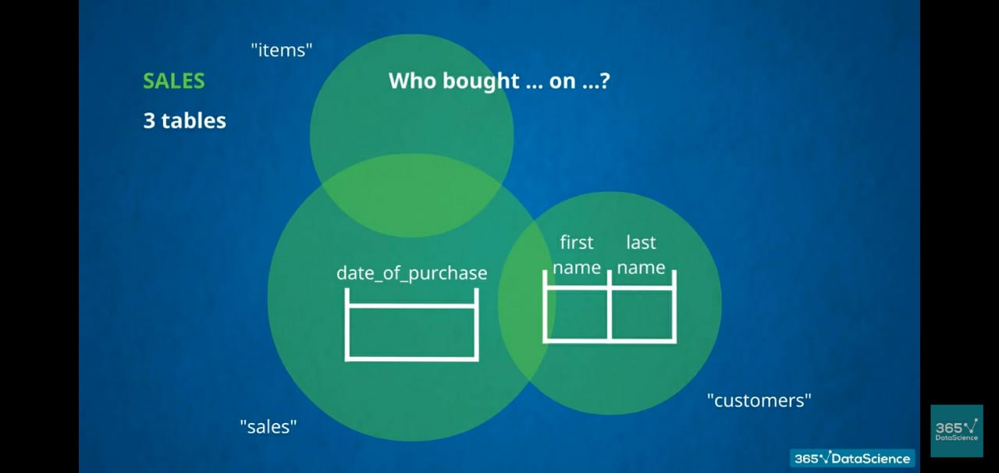
DATABASE: SHOP

Slide 18
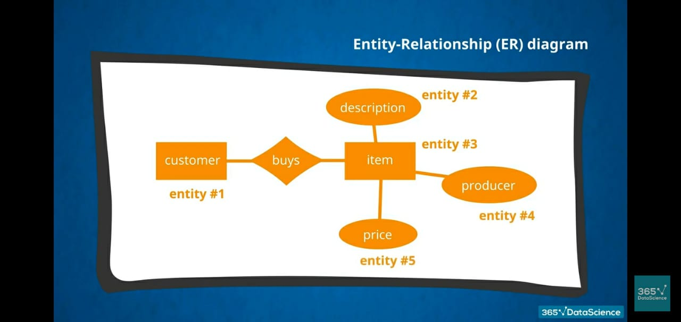
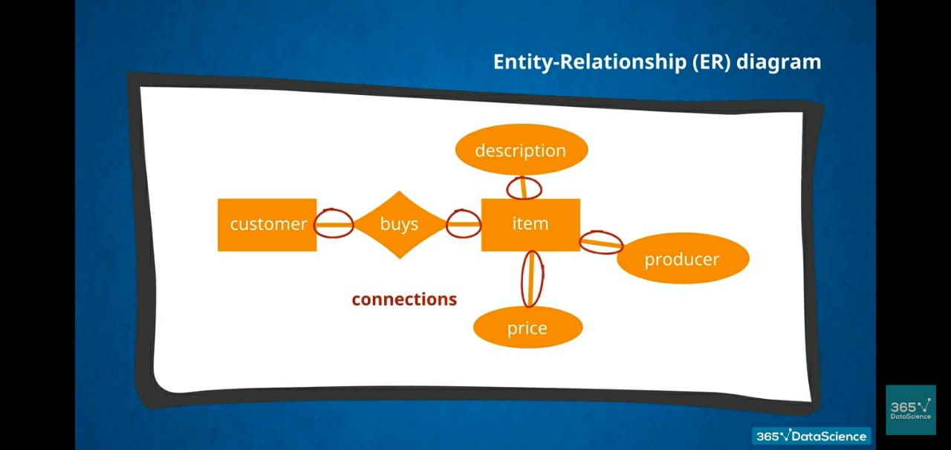

Slide 19
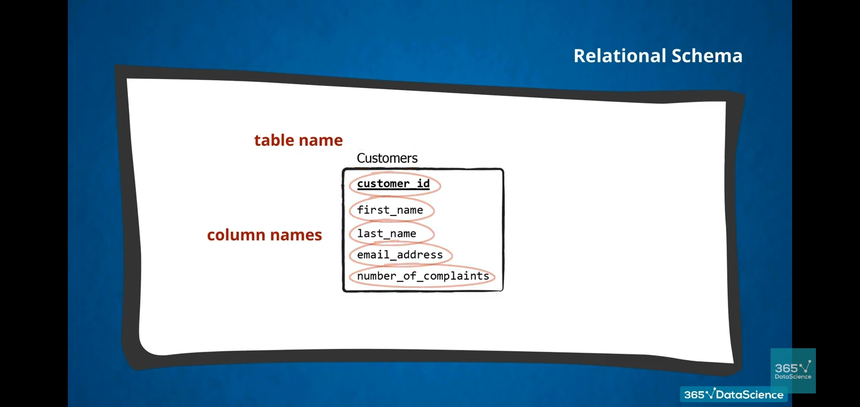
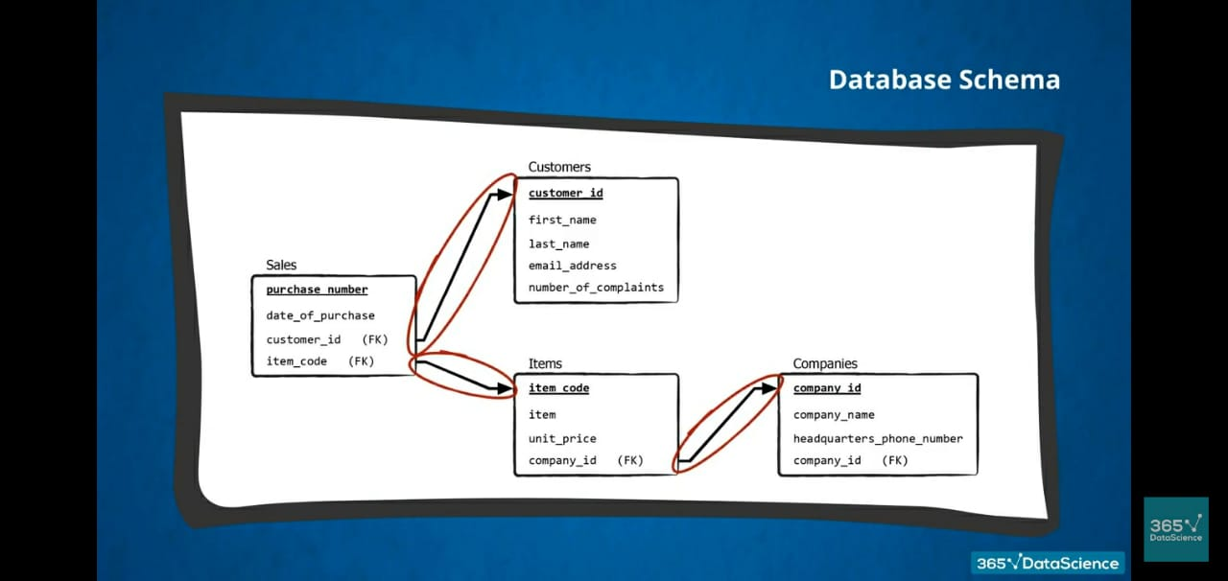

Slide 20
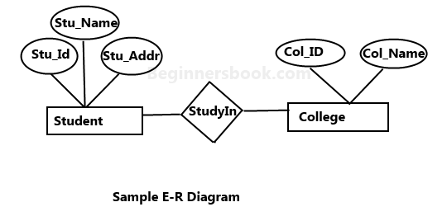
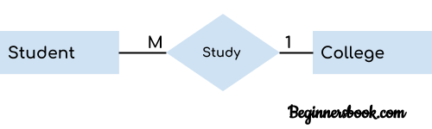
ER-Diagram:
An ER diagram shows the relationship among entity sets. An entity set is a group of similar entities and these entities can have attributes.
Rectangle: Represents Entity sets. Ellipses: Attributes Diamonds: Relationship Set Lines: They link attributes to Entity Sets and Entity sets to Relationship Set Double Ellipses: Multivalued Attributes Dashed Ellipses: Derived Attributes Double Rectangles: Weak Entity Sets Double Lines: Total participation of an entity in a relationship set
1. Entity 2. Attribute 3. Relationship

Slide 21
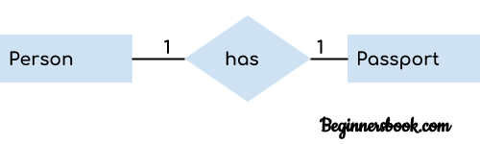
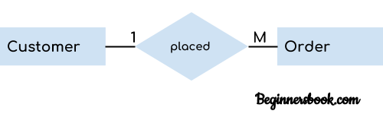
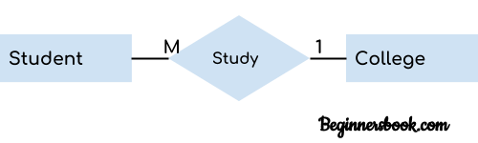
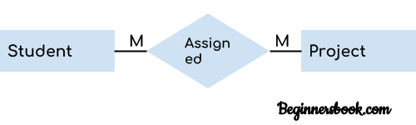
RELATIONSHIPS in ER-Diagram
One to One Relationship
One to Many Relationship
Many to One Relationship
Many to Many Relationship

Slide 22
Unique Key:
A unique key in MySQL is a single field or combination of fields that ensure all values going to store into the column will be unique. It means a column cannot stores duplicate values.
For example, the email addresses and roll numbers of students in the "student_info" table or contact number of employees in the "Employee" table should be unique.
It is useful in preventing the two records from storing identical values into the column.
It stores only distinct values that maintain the integrity and reliability of the database for accessing the information in an organized way.
It also works with a foreign key in preserving the uniqueness of a table.
It can contain null value into the table.
Syntax
CREATE TABLE table_name(
col1 datatype,
col2 datatype UNIQUE,
...
);
REFER WITH EXAMPLE: https://www.javatpoint.com/mysql-unique-key

Slide 23
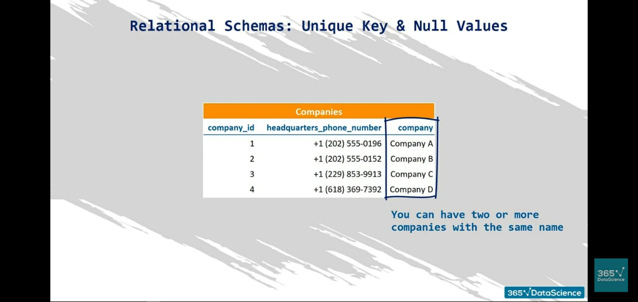
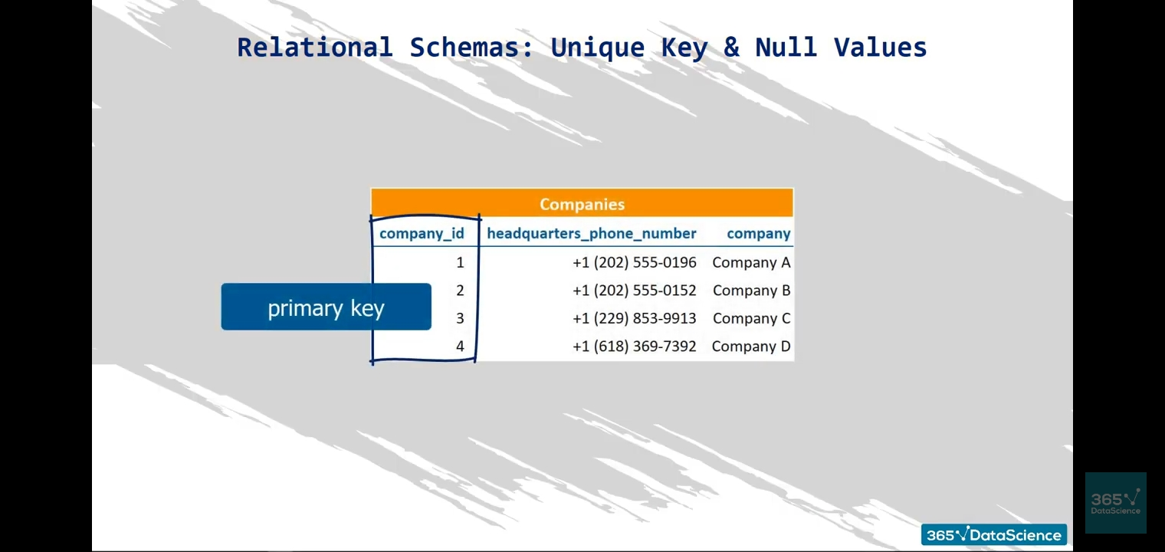

Slide 24
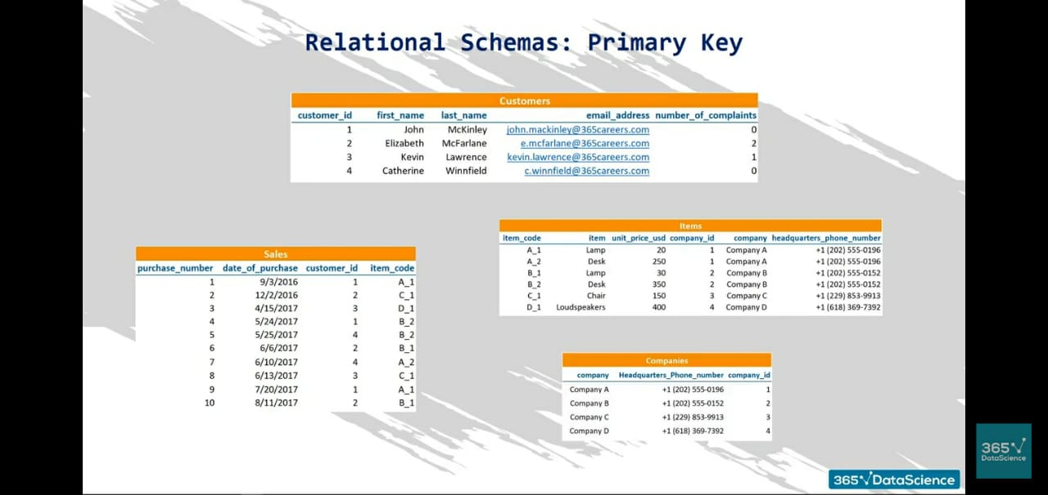

Slide 25
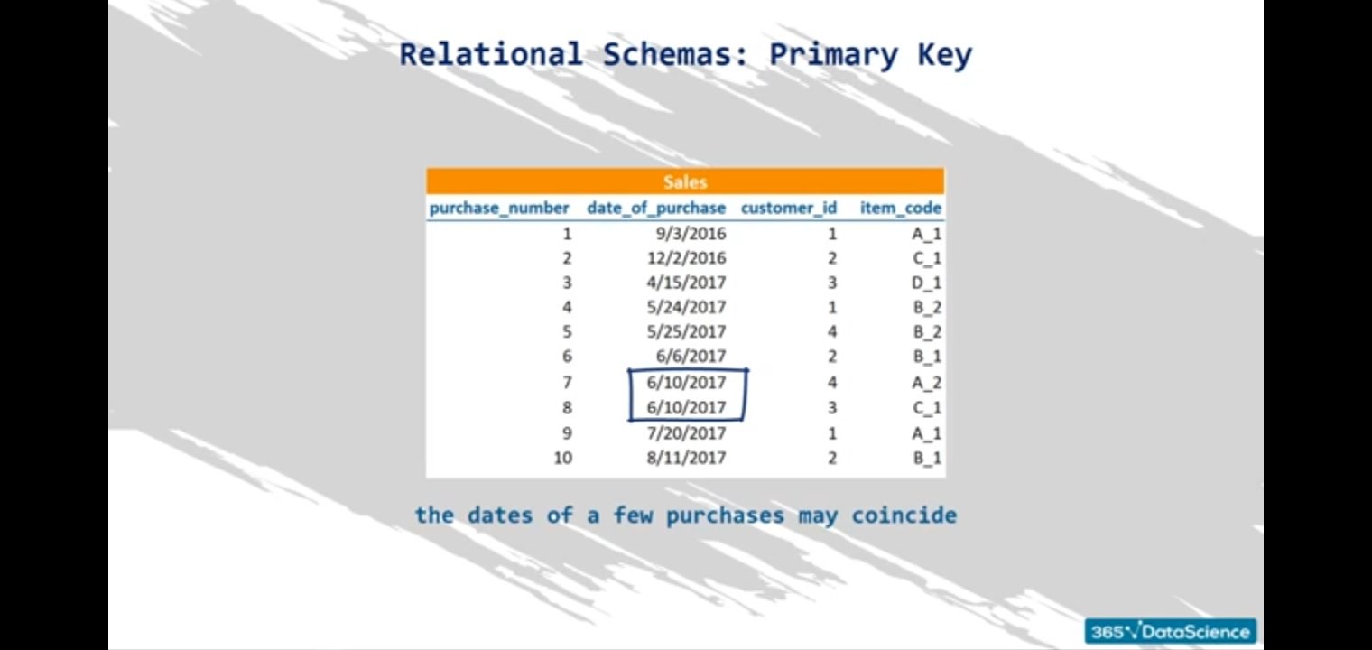
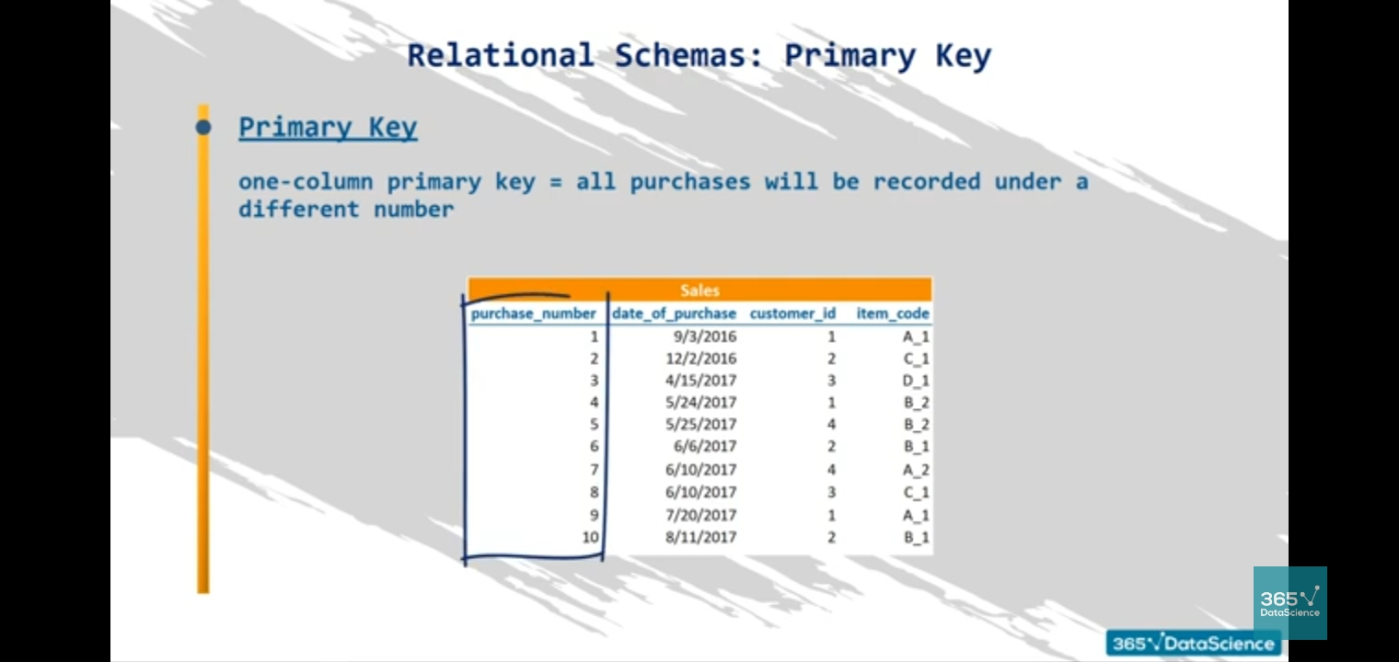
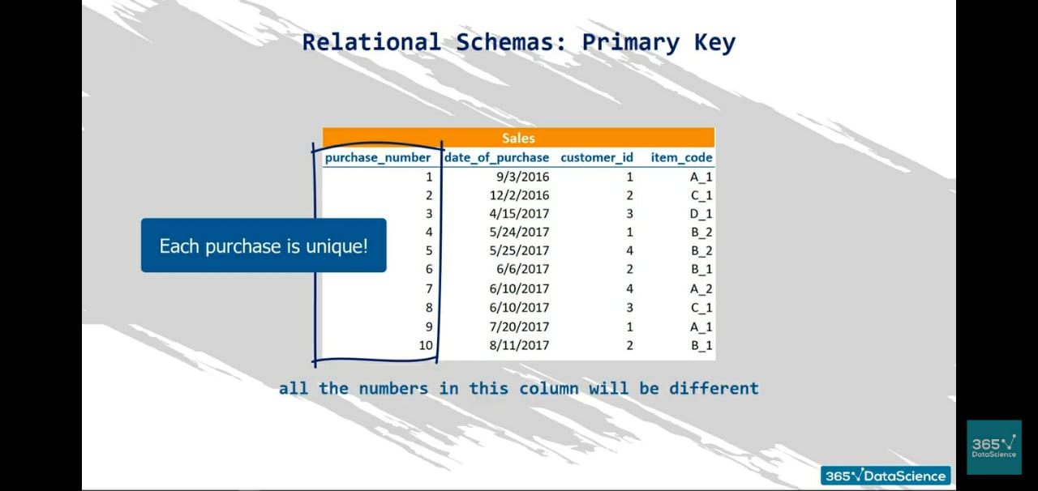
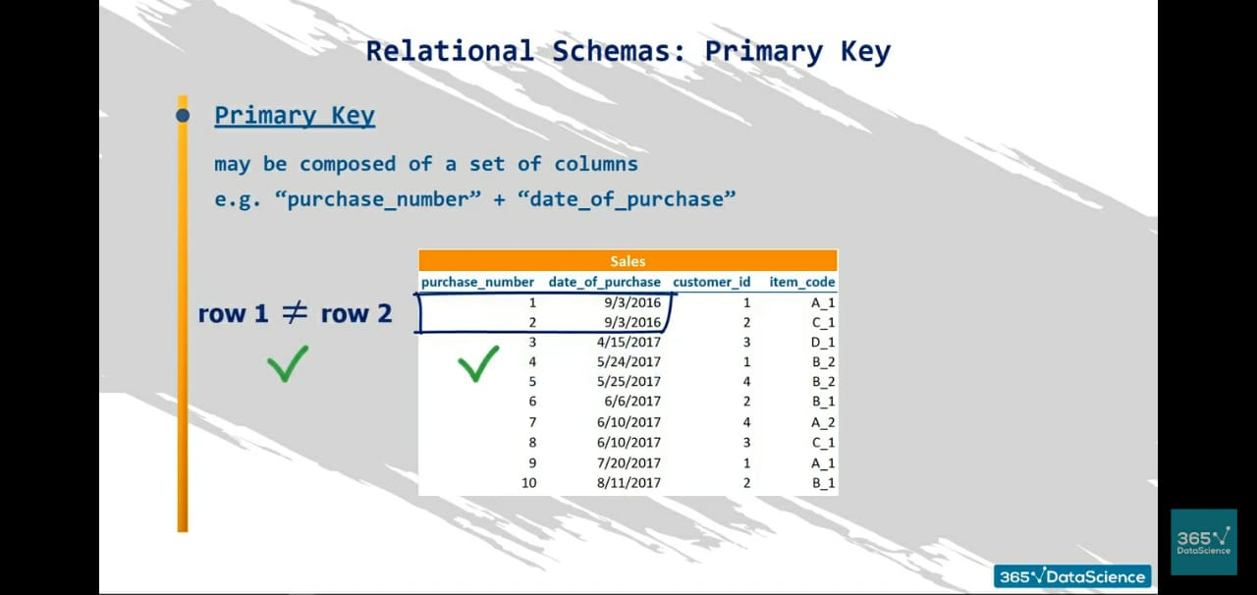

Slide 26
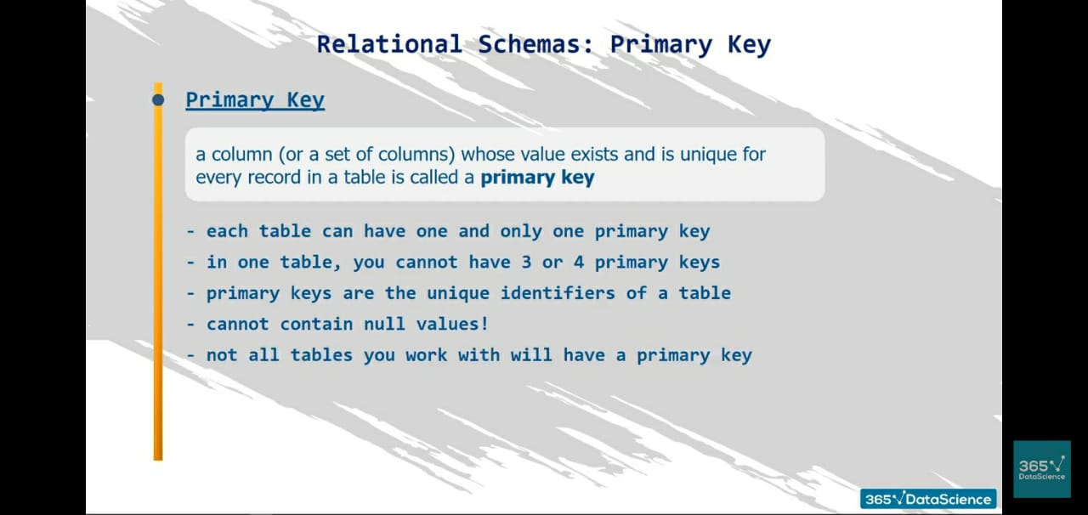
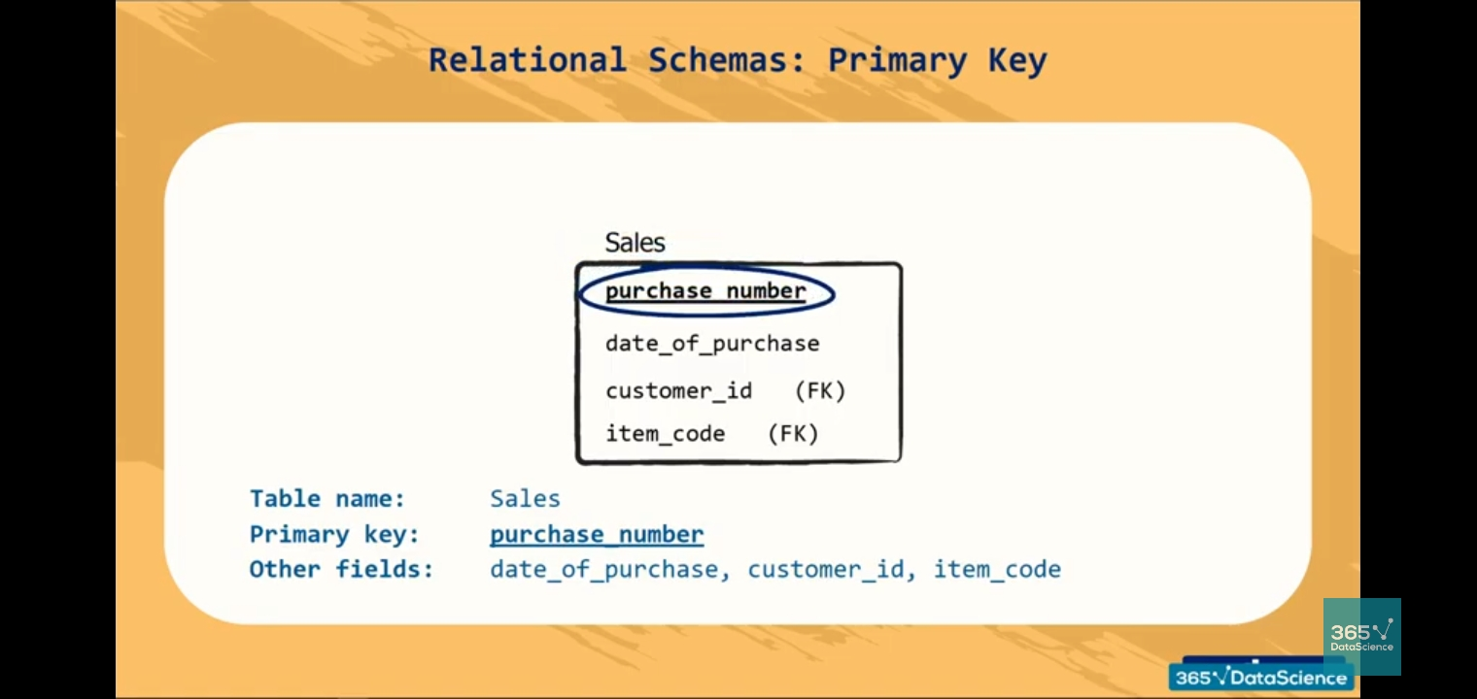
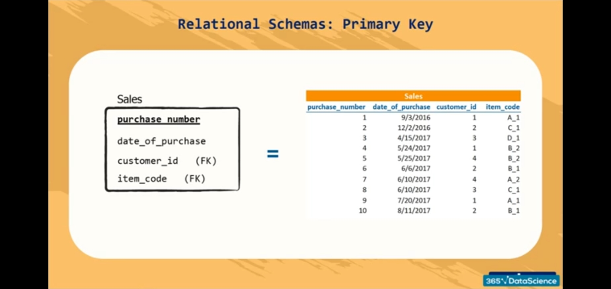

Slide 27
Primary Key:
MySQL primary key is a single or combination of the field, which is used to identify each record in a table uniquely. If the column contains primary key constraints, then it cannot be null or empty. A table may have duplicate columns, but it can contain only one primary key. It always contains unique value into a column.
When you insert a new row into the table, the primary key column can also use the AUTO_INCREMENT attribute to generate a sequential number for that row automatically.
Rules for Primary key
The primary key column value must be unique.
Each table can contain only one primary key.
The primary key column cannot be null or empty.
MySQL does not allow us to insert a new row with the existing primary key.
It is recommended to use INT or BIGINT data type for the primary key column.

Slide 28
Syntax:
CREATE TABLE table_name
(
col1 col_definition,
col2 col_definition,
...
CONSTRAINT [constraint_name]
PRIMARY KEY (column_name(s))
);
Refer link with example:
https://www.javatpoint.com/mysql-primary-key
CREATE TABLE Login(
login_id INT AUTO_INCREMENT PRIMARY KEY,
username VARCHAR(40),
password VARCHAR(55),
email VARCHAR(55)
);

Slide 29
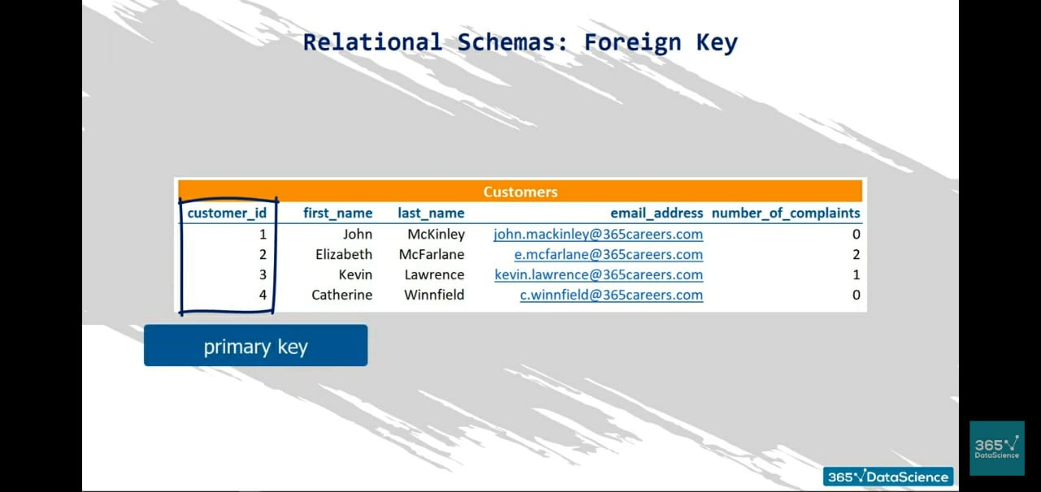
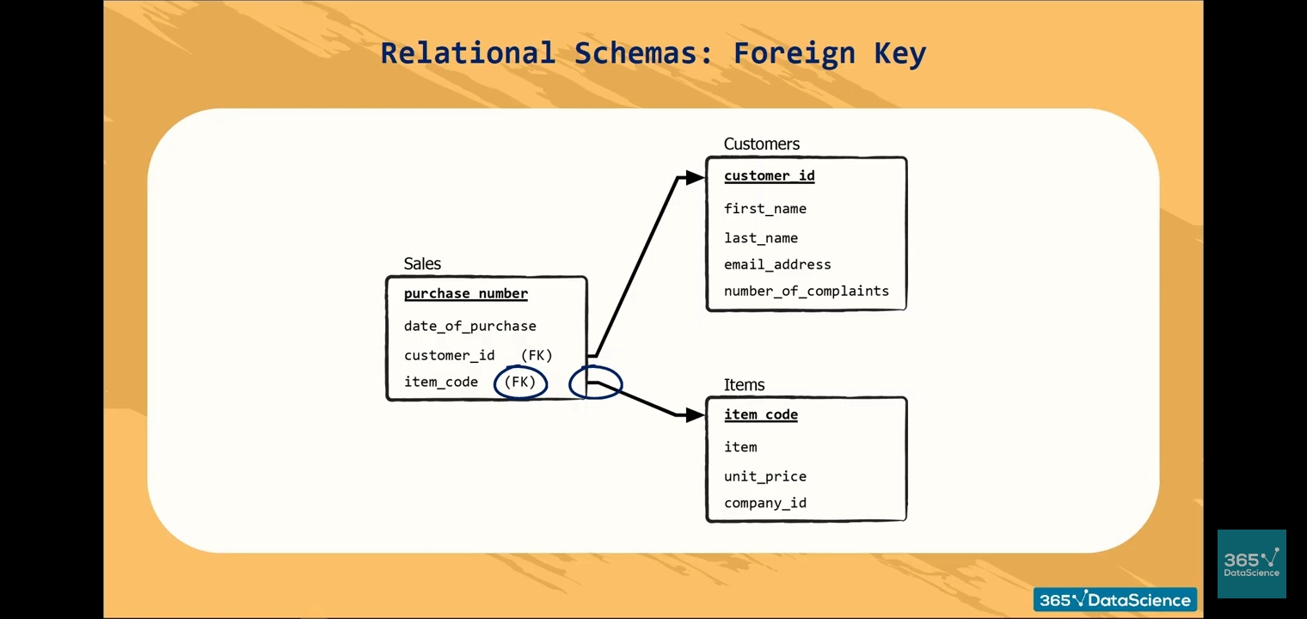
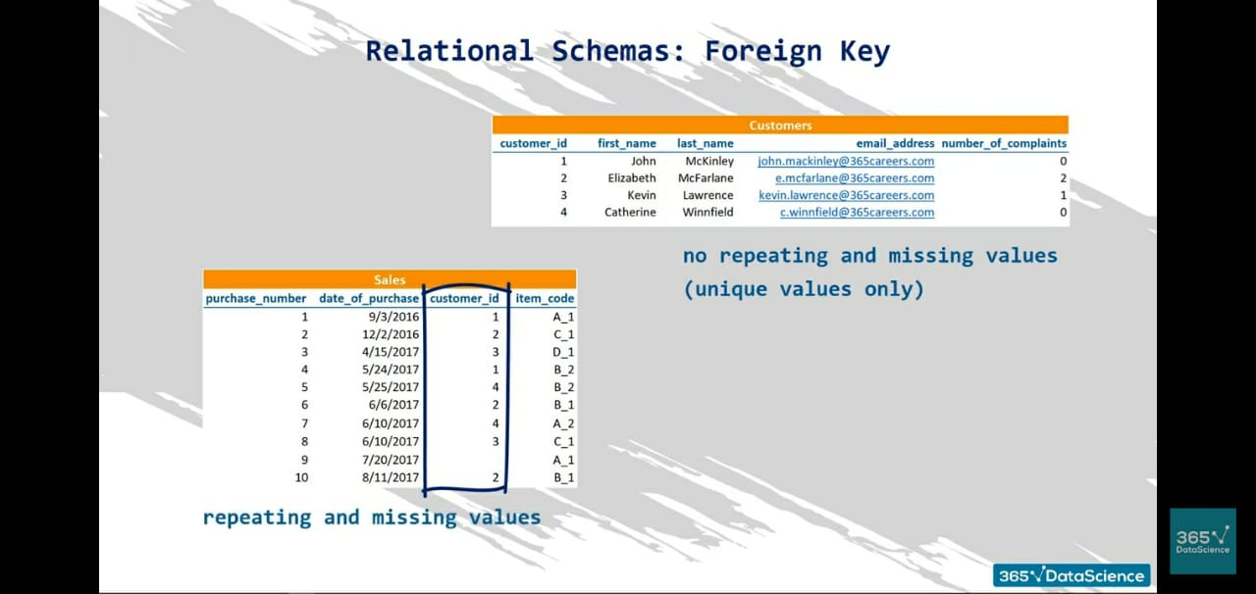

Slide 30
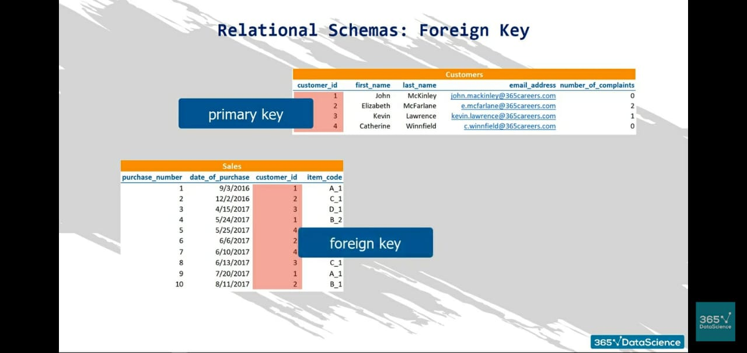
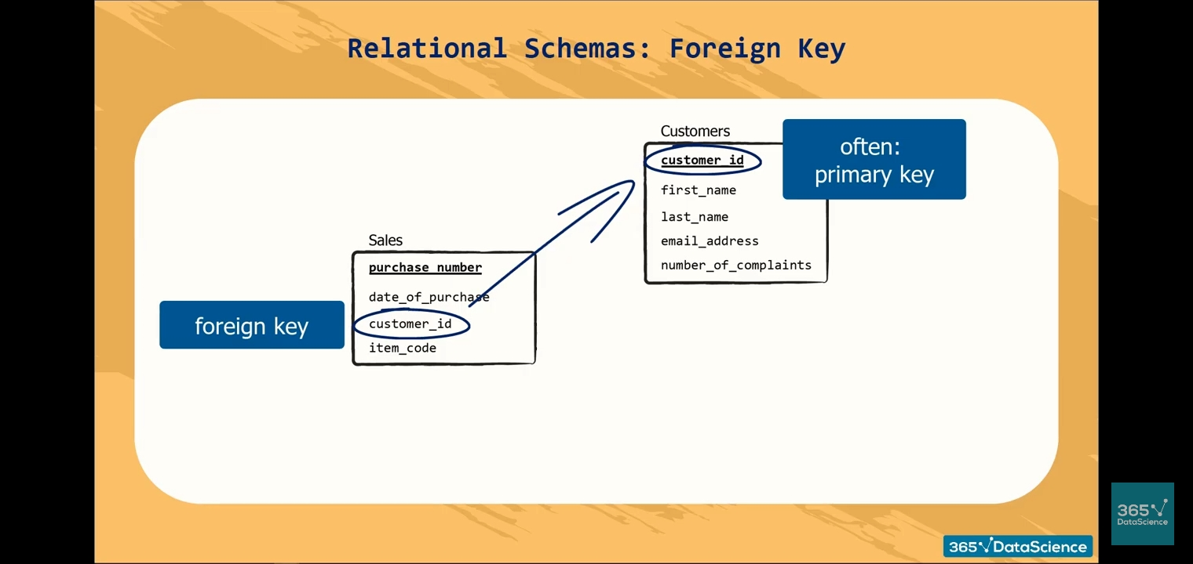

Slide 31
Foreign Key:
The foreign key is used to link one or more than one table together. It is also known as the referencing key. A foreign key matches the primary key field of another table. It means a foreign key field in one table refers to the primary key field of the other table. It identifies each row of another table uniquely that maintains the referential integrity in MySQL.
SYNTAX
[CONSTRAINT constraint_name]
FOREIGN KEY [foreign_key_name] (col_name, ...)
REFERENCES parent_tbl_name (col_name,...)
ON DELETE referenceOption ON UPDATE referenceOption
REFER WITH EXAMPLE:
https://www.javatpoint.com/mysql-foreign-key

Slide 32
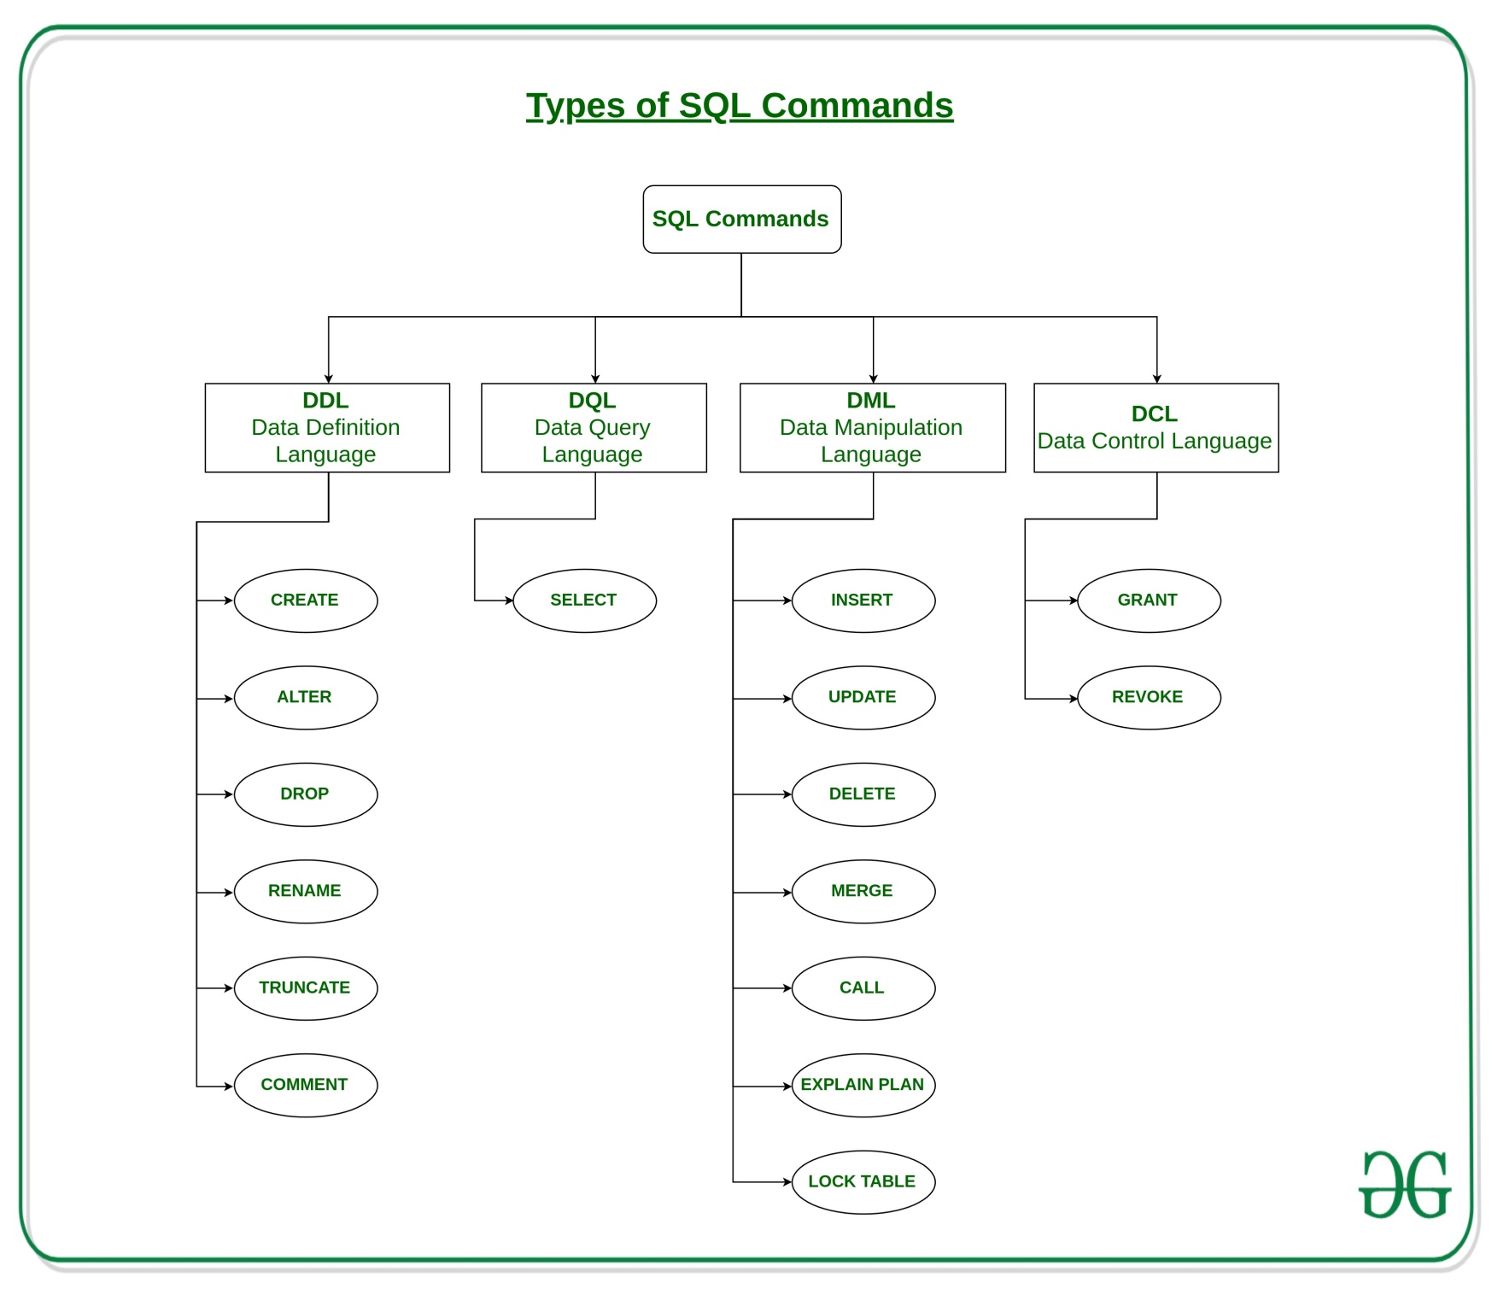

Slide 33
AUTO_INCREMENT
MySQL uses the AUTO_INCREMENT keyword to perform an auto-increment feature.
By default, the starting value for AUTO_INCREMENT is 1, and it will increment by 1 for each new record.
CREATE TABLE Persons ( Personid int NOT NULL AUTO_INCREMENT, LastName varchar(255) NOT NULL, FirstName varchar(255), Age int, PRIMARY KEY (Personid) );
ALTER TABLE Persons AUTO_INCREMENT=100;
To insert a new record into the "Persons" table, we will NOT have to specify a value for the "Personid" column (a unique value will be added automatically):
INSERT INTO Persons (FirstName,LastName) VALUES ('Lars','Monsen');

Slide 34
NOT NULL/NULL
NOT NULL means that the column can not have a NULL value for any record;.
NULL means NULL is an allowable value (even when the column has a foreign key constraint). ... Generally you want as many columns as possible to be NOT NULL because you want to be sure data is always there.
IS NOT NULL condition in a SELECT statement:
SELECT column_names FROM table_name WHERE column_name IS NOT NULL;
IS NOT NULL example will return all records from the contacts table where the last_name does not contain a null value.
SELECT CustomerName, ContactName, Address FROM Customers WHERE Address IS NULL;
SELECT CustomerName, ContactName, Address FROM Customers WHERE Address IS NOT NULL;

Slide 35
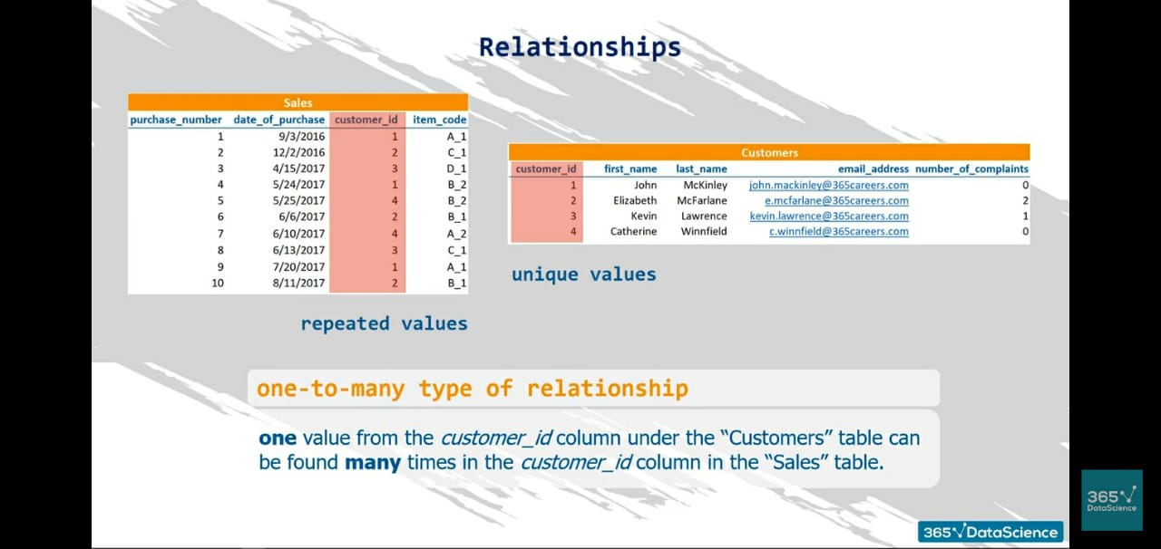
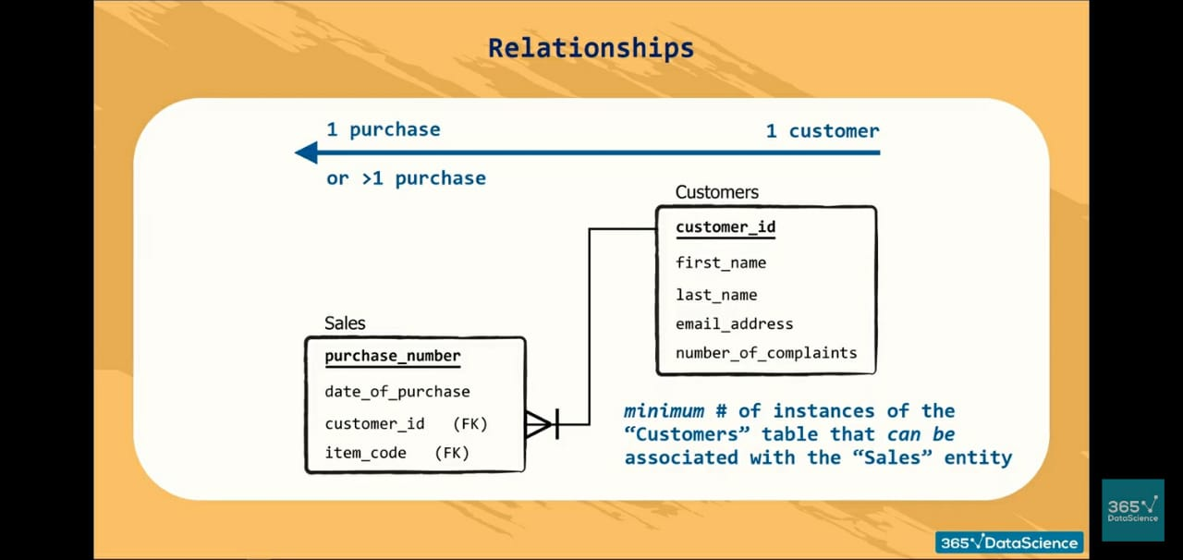

Slide 36
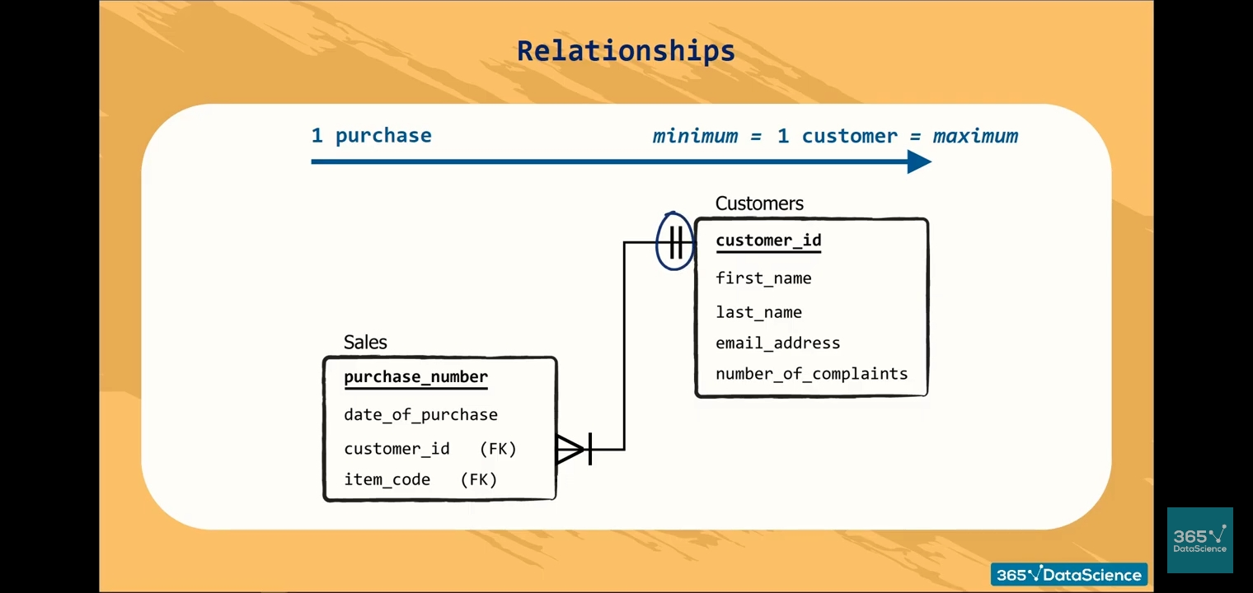
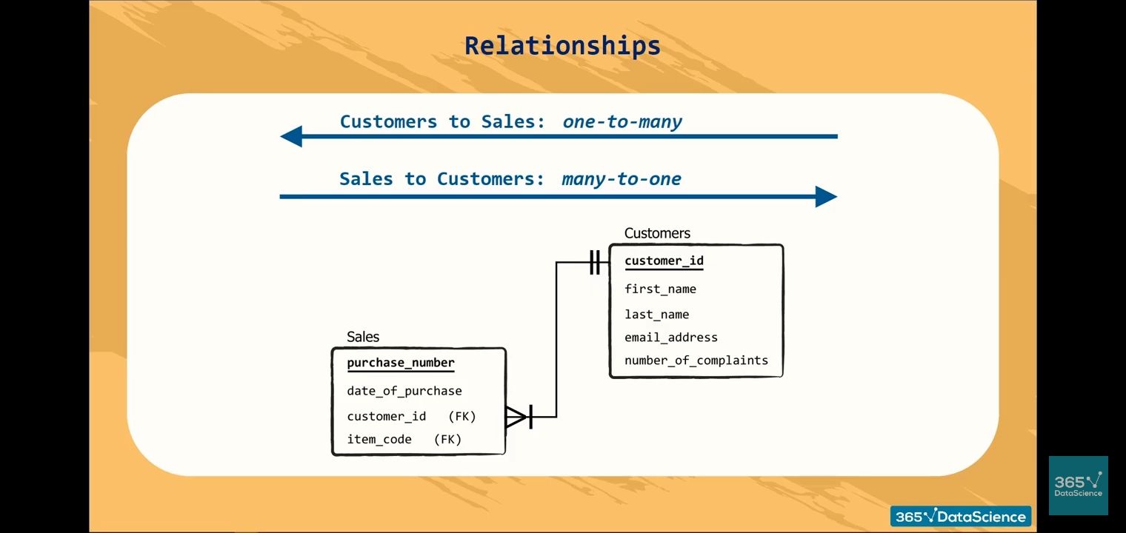
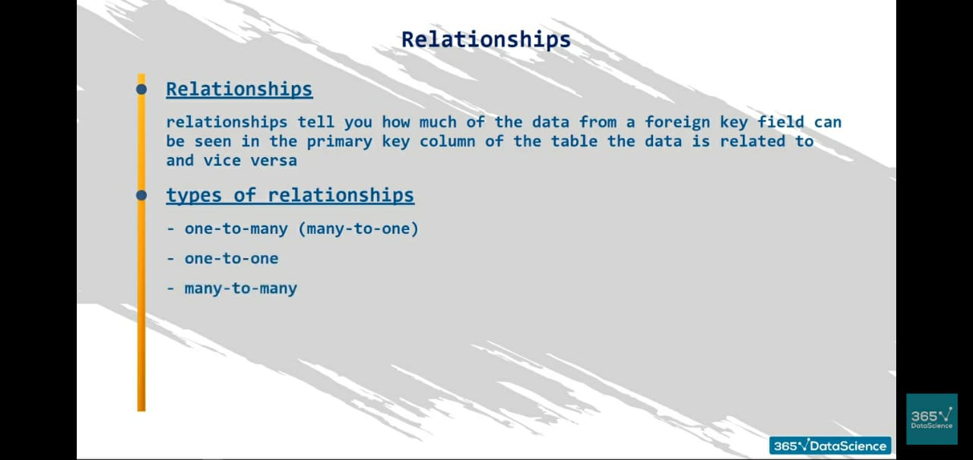

Slide 37
CREATE DATABASE Statement:
CREATE DATABASE statement is used to create a new SQL database.
Syntax
CREATE DATABASE databasename;
CREATE DATABASE Example
creates a database called "testDB":
CREATE DATABASE testDB;

Slide 38
DROP DATABASE Statement:
The DROP DATABASE statement is used to drop an existing SQL database.
Syntax
DROP DATABASE databasename;
Note: Be careful before dropping a database. Deleting a database will result in loss of complete information stored in the database!
DROP DATABASE testDB;

Slide 39
CREATE TABLE Statement:
The CREATE TABLE statement is used to create a new table in a database.
Syntax
CREATE TABLE table_name ( column1 datatype, column2 datatype, column3 datatype, .... );
The column parameters specify the names of the columns of the table.
The datatype parameter specifies the type of data the column can hold (e.g. varchar, integer, date, etc.).
CREATE TABLE Customers ( Customer_ID int NOT NULL AUTO_INCREMENT, FirstName varchar(255), LastName varchar(255), Email_address varchar(255), Number_of_complaints varchar(255),
PRIMARY KEY (Customer_ID) );

Slide 40
DROP TABLE Statement:
The DROP TABLE statement is used to drop an existing table in a database.
Syntax
DROP TABLE table_name;
DROP TABLE Shippers;
TRUNCATE TABLE table_name;

Slide 41
ALTER TABLE Statement:
The ALTER TABLE statement is used to add, delete, or modify columns in an existing table.
The ALTER TABLE statement is also used to add and drop various constraints on an existing table.
ALTER TABLE - ADD Column
To add a column in a table, use the following syntax:
ALTER TABLE table_name ADD column_name datatype;
ALTER TABLE Customers ADD Email varchar(255);
ALTER TABLE Customers DROP COLUMN Email;
ALTER TABLE Persons ADD DateOfBirth date;

Slide 42
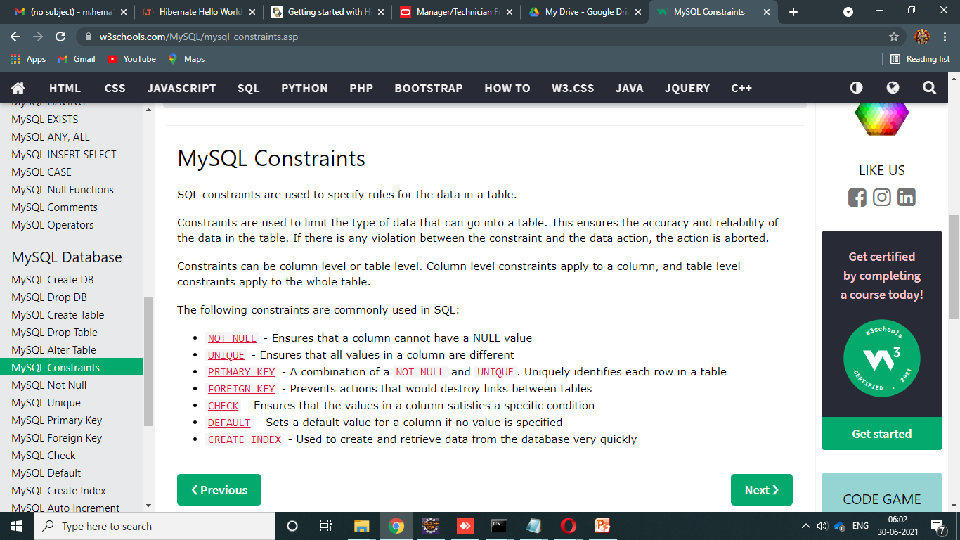
Constraints:
SQL constraints are used to specify rules for data in a table.
Constraints can be specified when the table is created with the CREATE TABLE statement, or after the table is created with the ALTER TABLE statement.
Syntax
CREATE TABLE table_name ( column1 datatype constraint, column2 datatype constraint, column3 datatype constraint, .... );
Constraints are used to limit the type of data that can go into a table. This ensures the accuracy and reliability of the data in the table. If there is any violation between the constraint and the data action, the action is aborted.
Constraints can be column level or table level. Column level constraints apply to a column, and table level constraints apply to the whole table.

Slide 43
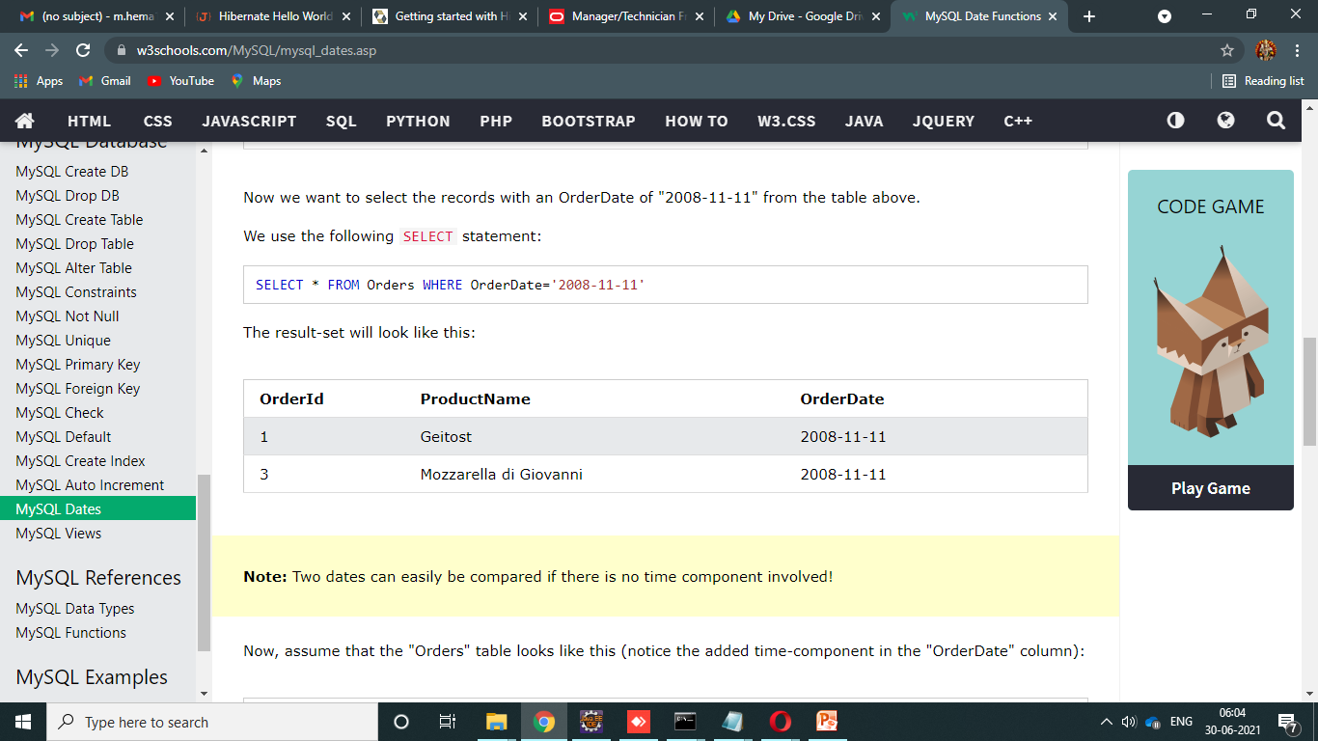
DATE Data Types:
MySQL comes with the following data types for storing a date or a date/time value in the database:
DATE - format YYYY-MM-DD
DATETIME - format: YYYY-MM-DD HH:MI:SS
TIMESTAMP - format: YYYY-MM-DD HH:MI:SS
YEAR - format YYYY or YY
SELECT * FROM Orders WHERE OrderDate='2008-11-11'

Slide 44
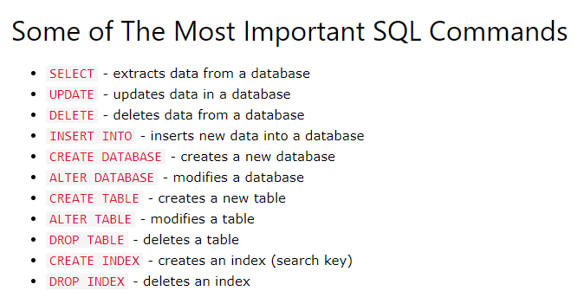

Slide 45
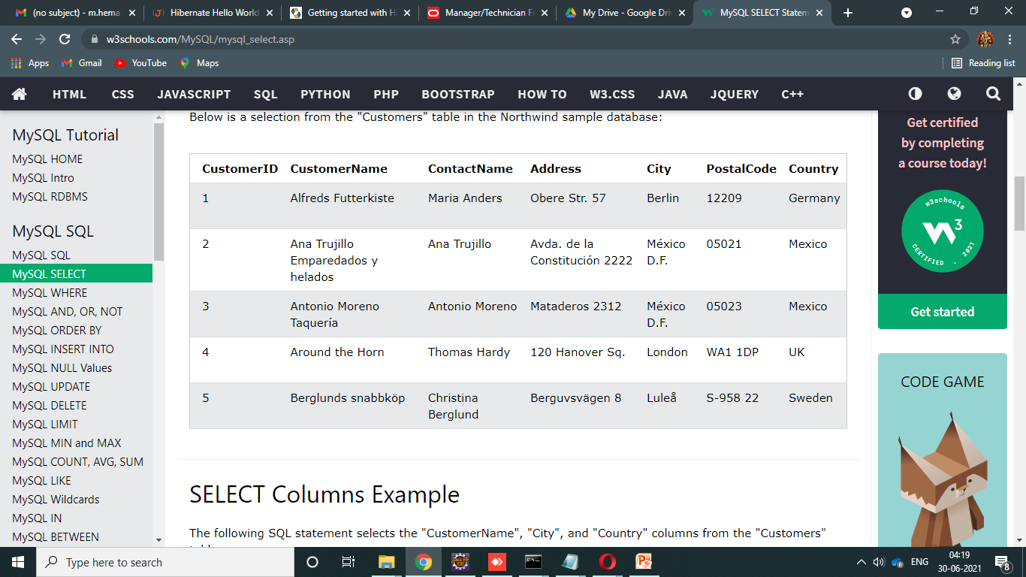
SELECT Statement :
The SELECT statement is used to select data from a database.
The data returned is stored in a result table, called the result-set.
SELECT Syntax
SELECT column1, column2, ... FROM table_name;
Here, column1, column2, ... are the field names of the table you want to select data from. If you want to select all the fields available in the table, use the following syntax:
SELECT * FROM table_name;
SELECT * FROM Customers;
SELECT Customer Name, City, Country FROM Customers;
TABLE: Customers

Slide 46
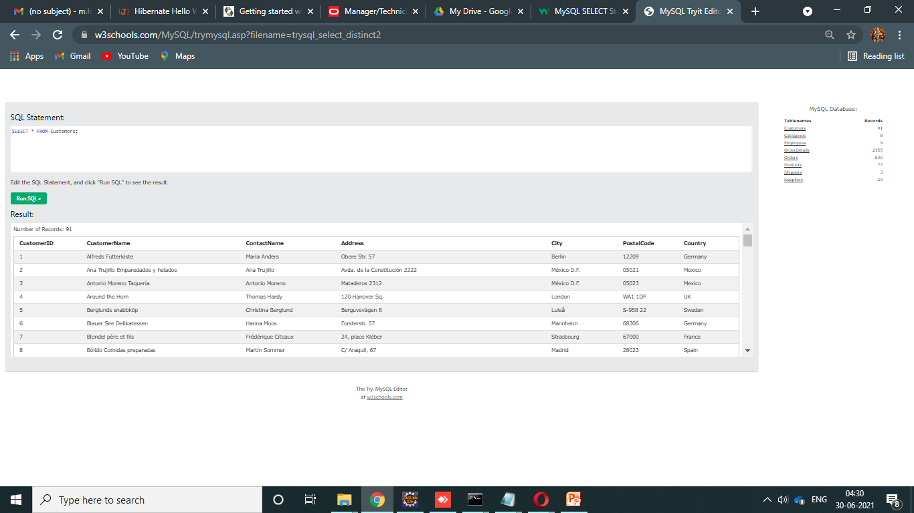
SELECT DISTINCT Statement:
The SELECT DISTINCT statement is used to return only distinct (different) values.
Inside a table, a column often contains many duplicate values; and sometimes you only want to list the different (distinct) values.
SELECT DISTINCT Syntax
SELECT DISTINCT column1, column2, ... FROM table_name;
The following SQL statement selects all (including the duplicates) values from the "Country" column in the "Customers" table:
Example
SELECT Country FROM Customers;
SELECT DISTINCT Country FROM Customers;
SELECT COUNT(DISTINCT Country) FROM Customers;

Slide 47


WHERE Clause:
The WHERE clause is used to filter records.
It is used to extract only those records that fulfill a specified condition.
WHERE Syntax:
SELECT column1, column2, ... FROM table_name WHERE condition;

Slide 48

BETWEEN Operator:
The BETWEEN operator selects values within a given range. The values can be numbers, text, or dates.
The BETWEEN operator is inclusive: begin and end values are included.
BETWEEN Syntax
SELECT column_name(s) FROM table_name WHERE column_name BETWEEN value1 AND value2;
SELECT * FROM Products WHERE Price BETWEEN 10 AND 20;
SELECT * FROM Products WHERE Price NOT BETWEEN 10 AND 20;
SELECT * FROM Products WHERE Price BETWEEN 10 AND 20 AND CategoryID NOT IN (1,2,3);
SELECT * FROM Products WHERE ProductName BETWEEN 'Carnarvon Tigers' AND 'Mozzarella di Giovanni' ORDER BY ProductName;
SELECT * FROM Orders WHERE OrderDate BETWEEN '1996-07-01' AND '1996-07-31';

Slide 49

LIKE Operator:
The LIKE operator is used in a WHERE clause to search for a specified pattern in a column.
There are two wildcards often used in conjunction with the LIKE operator:
The percent sign (%) represents zero, one, or multiple characters
The underscore sign (_) represents one, single character
The percent sign and the underscore can also be used in combinations!
LIKE Syntax
SELECT column1, column2, ... FROM table_name WHERE columnN LIKE pattern;
SELECT * FROM Customers WHERE CustomerName LIKE 'a%';

Slide 50
IN Operator:
The IN operator allows you to specify multiple values in a WHERE clause.
The IN operator is a shorthand for multiple OR conditions.
IN Syntax
SELECT column_name(s) FROM table_name WHERE column_name IN (value1, value2, ...);
or:
SELECT column_name(s) FROM table_name WHERE column_name IN (SELECT STATEMENT);
SELECT * FROM Customers WHERE Country IN ('Germany', 'France', 'UK');
SELECT * FROM Customers WHERE Country NOT IN ('Germany', 'France', 'UK');
SELECT * FROM Customers WHERE Country IN (SELECT Country FROM Suppliers);

Slide 51
AND, OR and NOT Operators:
The WHERE clause can be combined with AND, OR, and NOT operators.
The AND and OR operators are used to filter records based on more than one condition:
The AND operator displays a record if all the conditions separated by AND are TRUE.
The OR operator displays a record if any of the conditions separated by OR is TRUE.
The NOT operator displays a record if the condition(s) is NOT TRUE.
AND Syntax
SELECT column1, column2, ... FROM table_name WHERE condition1 AND condition2 AND condition3 ...; SELECT * FROM Customers WHERE Country = 'Germany' AND City = 'Berlin';
OR Syntax
SELECT column1, column2, ... FROM table_name WHERE condition1 OR condition2 OR condition3 ...; SELECT * FROM Customers WHERE City = 'Berlin' OR City = 'Stuttgart';
NOT Syntax
SELECT column1, column2, ... SELECT * FROM Customers WHERE NOT Country = 'Germany'; WHERE NOT condition;
FROM table_name SELECT * FROM Customers WHERE Country = 'Germany' AND (City = 'Berlin' OR City = 'Stuttgart');

Slide 52

ORDER BY Keyword:
The ORDER BY keyword is used to sort the result-set in ascending or descending order.
The ORDER BY keyword sorts the records in ascending order by default. To sort the records in descending order, use the DESC keyword.
ORDER BY Syntax
SELECT column1, column2, ... FROM table_name ORDER BY column1, column2, ... ASC|DESC;
ORDER BY DESC Example:
The following SQL statement selects all customers from the "Customers" table, sorted DESCENDING by the "Country" column:
SELECT * FROM Customers ORDER BY Country DESC;

Slide 53

INSERT INTO Statement:
The INSERT INTO statement is used to insert new records in a table.
INSERT INTO Syntax
It is possible to write the INSERT INTO statement in two ways:
1. Specify both the column names and the values to be inserted:
INSERT INTO table_name (column1, column2, column3, ...) VALUES (value1, value2, value3, ...);
INSERT INTO table_name VALUES (value1, value2, value3, ...);
INSERT INTO Customers (CustomerName, ContactName, Address, City, PostalCode, Country) VALUES ('Cardinal', 'Tom B. Erichsen', 'Skagen 21', 'Stavanger', '4006', 'Norway');

Slide 54

UPDATE Statement:
The UPDATE statement is used to modify the existing records in a table.
UPDATE Syntax
UPDATE table_name SET column1 = value1, column2 = value2, ... WHERE condition;
UPDATE Customers SET ContactName = 'Alfred Schmidt', City = 'Frankfurt' WHERE CustomerID = 1;

Slide 55
DELETE Statement:
The DELETE statement is used to delete existing records in a table.
DELETE Syntax
DELETE FROM table_name WHERE condition;
DELETE FROM Customers WHERE CustomerName='Alfreds Futterkiste';

Slide 56

LIMIT :
It selects the first three records from the "Customers" table:
Example
SELECT * FROM Customers LIMIT 3;

Slide 57
MIN() and MAX() Functions:
The MIN() function returns the smallest value of the selected column.
The MAX() function returns the largest value of the selected column.
MIN() Syntax
SELECT MIN(column_name) FROM table_name WHERE condition;
MAX() Syntax
SELECT MAX(column_name) FROM table_name WHERE condition;
SELECT MIN(Price) AS SmallestPrice FROM Products;
SELECT MAX(Price) AS LargestPrice FROM Products;

Slide 58
COUNT(), AVG() and SUM() Functions:
The COUNT() function returns the number of rows that matches a specified criterion.
COUNT() Syntax
SELECT COUNT(column_name) FROM table_name WHERE condition;
The AVG() function returns the average value of a numeric column.
AVG() Syntax
SELECT AVG(column_name) FROM table_name WHERE condition;
The SUM() function returns the total sum of a numeric column.
SUM() Syntax
SELECT SUM(column_name) FROM table_name WHERE condition;
SELECT COUNT(ProductID) FROM Products;
SELECT AVG(Price) FROM Products;
SELECT SUM(Quantity) FROM OrderDetails;

Slide 59

MySQL Aliases:
Aliases are used to give a table, or a column in a table, a temporary name.
Aliases are often used to make column names more readable.
An alias only exists for the duration of that query.
An alias is created with the AS keyword.
Alias Column Syntax
SELECT column_name AS alias_name FROM table_name;
Alias Table Syntax
SELECT column_name(s) FROM table_name AS alias_name;
SELECT CustomerID AS ID, CustomerName AS Customer FROM Customers;
SELECT CustomerName, CONCAT_WS(', ', Address, PostalCode, City, Country) AS Address FROM Customers;
SELECT o.OrderID, o.OrderDate, c.CustomerName FROM Customers AS c, Orders AS o WHERE c.CustomerName='Around the Horn' AND c.CustomerID=o.CustomerID;

Slide 60

JOIN QUERY’S Refer: https://www.javatpoint.com/mysql-join

Slide 61


Slide 62

What are JOINS?
Joins help retrieving data from two or more database tables.
The tables are mutually related using primary and foreign keys.
Cross JOIN:
Cross JOIN is a simplest form of JOINs which matches each row from one database table to all rows of another.
In other words it gives us combinations of each row of first table with all records in second table.
Suppose we want to get all member records against all the movie records, we can use the script shown below to get our desired results.
SELECT * FROM `movies` CROSS JOIN `members`

Slide 63
INNER Join
The INNER JOIN is used to return all rows from multiple tables where the join condition is satisfied. It is the most common type of join.
Syntax:
SELECT columns FROM table1 INNER JOIN table2 ON table1.column = table2.column;
LEFT Outer Join
The LEFT OUTER JOIN returns all rows from the left hand table specified in the ON condition and only those rows from the other table where the join condition is fulfilled.
Syntax:
SELECT columns FROM table1 LEFT [OUTER] JOIN table2 ON table1.column = table2.column;
Right Outer Join
The MySQL Right Outer Join returns all rows from the Right-hand table specified in the ON condition and only those rows from the other table where he join condition is fulfilled.
Syntax:
SELECT columns FROM table1 RIGHT [OUTER] JOIN table2 ON table1.column = table2.column;

Slide 64
Equi Join/Inner Join
Inner/Equi join (Returns Only matched records from Tab1 & Tab2)
SELECT * FROM tab1 INNER JOIN tab2 ON tab1.NumID = tab2.NumID;
Right outer join (Returns matched records + unmatched from right table tab1)
SELECT * FROM tab1 RIGHT JOIN tab2 ON tab1.NumID = tab2.NumID;
Left outer join (Returns matched records + unmatched from tight table tab2)
SELECT * FROM tab1 LEFT JOIN tab2 ON tab1.NumID=tab2.NumID;
Full outer join (Returns matched records + unmatched from both tables)---not supported in MYSQL.
SELECT * FROM tab1 FULL JOIN tab2 t2 ON t1.NumID = =t2.NumID;

Slide 65
Trigger:
A trigger in MySQL is a set of SQL statements that reside in a system catalog. It is a special type of stored procedure that is invoked automatically in response to an event. Each trigger is associated with a table, which is activated on any DML statement such as INSERT, UPDATE, or DELETE.
Generally, triggers are of two types according to the SQL standard: row-level triggers and statement-level triggers.
Row-Level Trigger: It is a trigger, which is activated for each row by a triggering statement such as insert, update, or delete. For example, if a table has inserted, updated, or deleted multiple rows, the row trigger is fired automatically for each row affected by the insert, update, or delete statement.
Statement-Level Trigger: It is a trigger, which is fired once for each event that occurs on a table regardless of how many rows are inserted, updated, or deleted.
REFER LINK: https://phoenixnap.com/kb/mysql-trigger

Slide 66
We can define the maximum six types of actions or events in the form of triggers:
Before Insert: It is activated before the insertion of data into the table.
After Insert: It is activated after the insertion of data into the table.
Before Update: It is activated before the update of data in the table.
After Update: It is activated after the update of the data in the table.
Before Delete: It is activated before the data is removed from the table.
After Delete: It is activated after the deletion of data from the table.
When we use a statement that does not use INSERT, UPDATE or DELETE query to change the data in a table, the triggers associated with the trigger will not be invoked.
(BEFOR | AFTER) table_name (INSERT | UPDATE | DELETE)
Trigger Activation Time: BEFORE | AFTER
Trigger Event: INSERT | UPDATE | DELETE

Slide 67
How to create triggers in MySQL?
We can use the CREATE TRIGGER statement
for creating a new trigger in MySQL.
Below is the syntax of creating a trigger in MySQL:
SHOW triggers;
CREATE TRIGGER trigger_name
(AFTER | BEFORE) (INSERT | UPDATE | DELETE)
ON table_name FOR EACH ROW
BEGIN
--variable declarations
--trigger code
END;

Slide 68




Slide 69



Slide 70






Slide 71
SUBQUERIES
Subquery is a query within a query.
Sub query contains 2 parts
Outer query.
Inner query.
The output of inner query is become input of outer query.
2 Types of subQueries:
Single row sub query, <=,>=,!=
Multi row Query,IN , ANY, ALL

Slide 72
Single row sub queries
Display employees whose salary is grater than of ellen:
SELECT * FROM EMPLOYEE1 WHERE SALARY>(SELECT SALARY FROM EMPLOYEE1 WHERE FIRST_NAME=‘Ellen’);
2nd max salary from employee:
SELECT MAX(SALARY)FROM EMPLOYEE1 WHERE SALARY>(SELECT MAX(SALARY)FROM EMPLOYEE1 );

Slide 73
Find the salary of employees whose salary is greater than the salary of employee whose EMPLOYEE_ID 102:
SELECT SALARY FROM EMPLOYEE1 WHERE SALARY>(SELECT SALARY FROM EMPLOYEE1 WHERE EMPLOYEE_ID=102);
Display the employees who all are earning the highest salary:
SELECT * FROM EMPLOYEE1 WHERE SALARY = (SELECT MAX(SALARY) FROM EMPLOYEE1 );

Slide 74
Multi row sub queries
Query to get department name of the employee:
SELECT FIRST_NAME , EMPLOYEE_ID , DEPARTMENT_ID,(SELECT DEPARTMENT_NAME FROM DEPARTMENT1 WHERE EMPLOYEE1.DEPARTMENT_ID = DEPARTMENT1.DEPARTMENT_ID ) DNAME FROM EMPLOYEE1;
List out the employees who are having salary less than the maximum salary and also having hire date greater than the hire date of an employee who is having maximum salary:
SELECT EMPLOYEE_ID , FIRST_NAME SALARY, HIRE_DATE FROM EMPLOYEE1 WHERE SALARY <
(SELECT MAX(SALARY) FROM EMPLOYEE1) AND HIRE_DATE >
(SELECT HIRE_DATE FROM EMPLOYEE1 WHERE SALARY =
(SELECT MAX(SALARY) FROM EMPLOYEE1 ) );

Slide 75
REFERENCE:
MySQL Join – javatpoint
SQL Joins - W3Schools
https://youtu.be/cpbd7CLAqtw (MySQL)
https://youtu.be/HXV3zeQKqGY (SQL)
https://www.javatpoint.com/mysql-workbench
https://www.javatpoint.com/how-to-install-mysql

Slide 76


